Slide 1
Лекция 13
Кубы OLAP и многомерные выражения

Slide 2
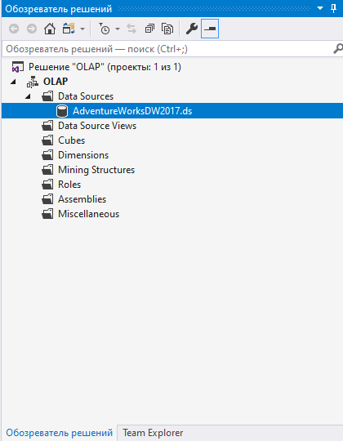
Создание olap- кубов
Для создания куба OLAP необходимо использовать службы Analysis Services. Мы используем базу данных Adventureworks 2017

Slide 3
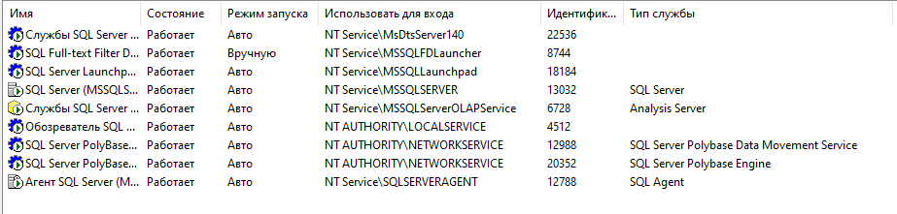
Создание olap- кубов
Чтобы избежать проблем с подключением к базе данных, необходимо проверить параметры подключения в SQL Server Analysis Services, параметры входа в качестве SQL Server и SQL Server Analysis Services.

Slide 4
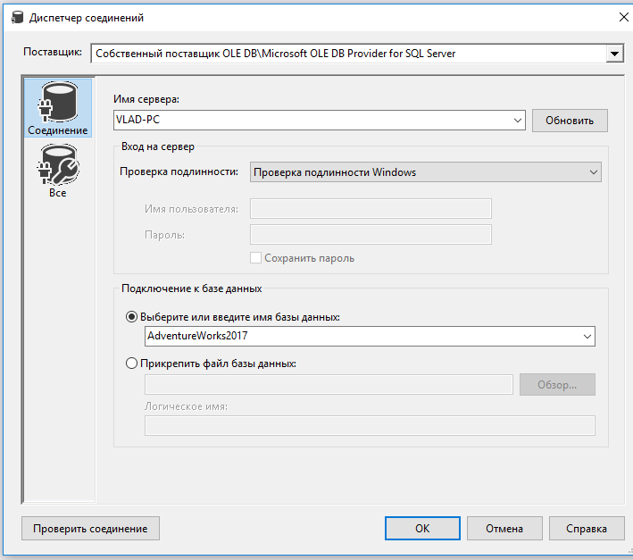
Создание olap- кубов
Чтобы создать куб OLAP, вам потребуется создать проект Business Intelligence в Microsoft Visual Studio. Установите инструмент SSDT, и вы сможете создать проект такого типа в Visual Studio.

Slide 5
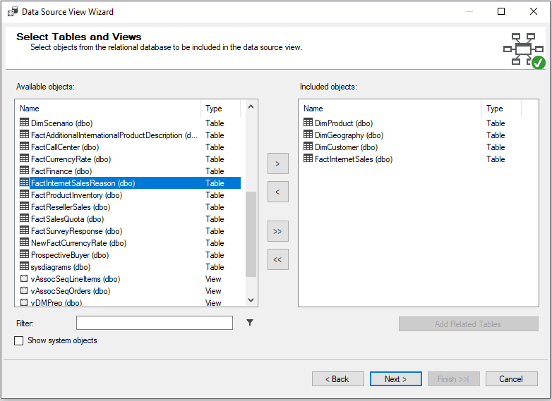
Создание кубов OLAP
В представлении источника данных выберите нужные таблицы, из которых будет построен куб OLAP.

Slide 6
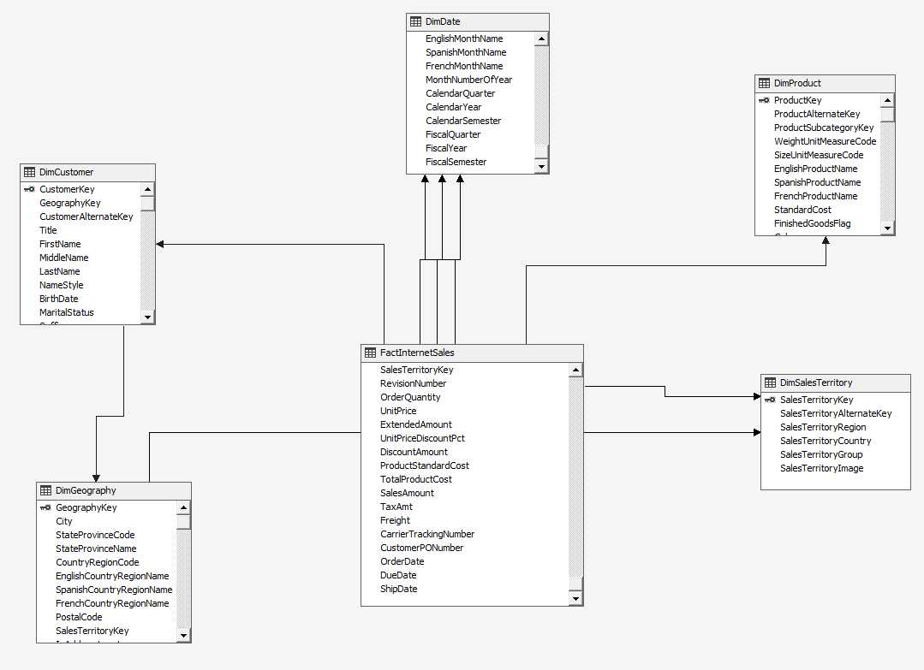
Создание кубов OLAP

Slide 7
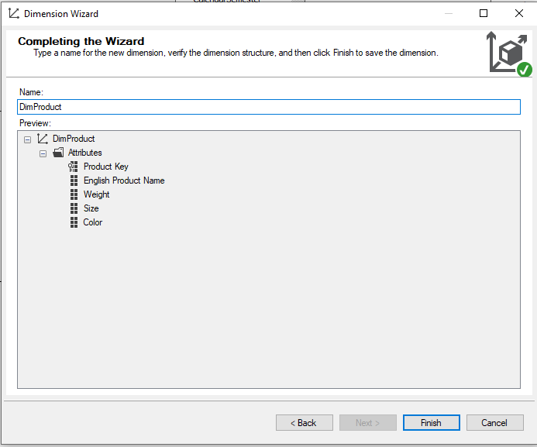
Создать размеры

Slide 8
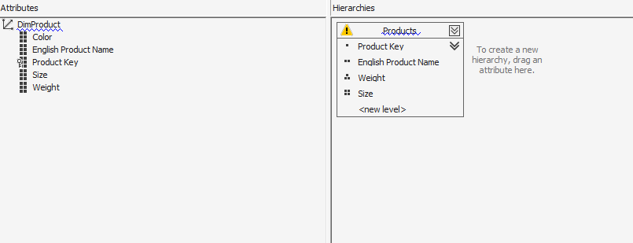
Создать размеры

Slide 9
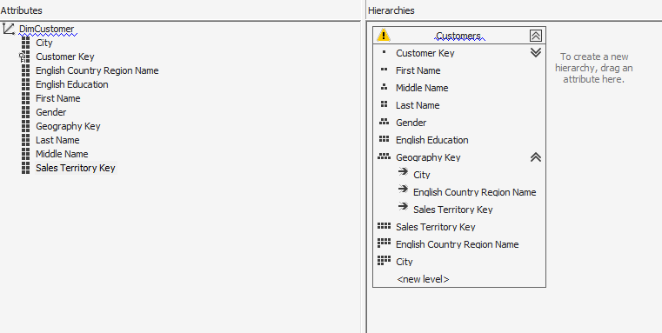
Создать размеры

Slide 10
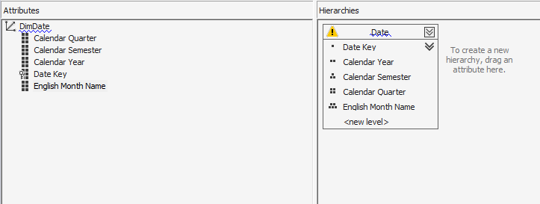
Создать размеры

Slide 11
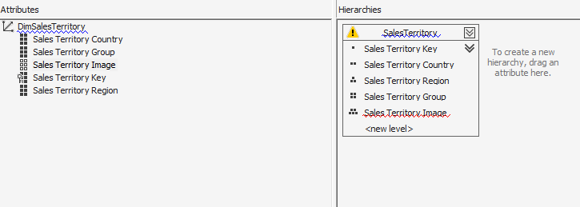
Создать размеры

Slide 12
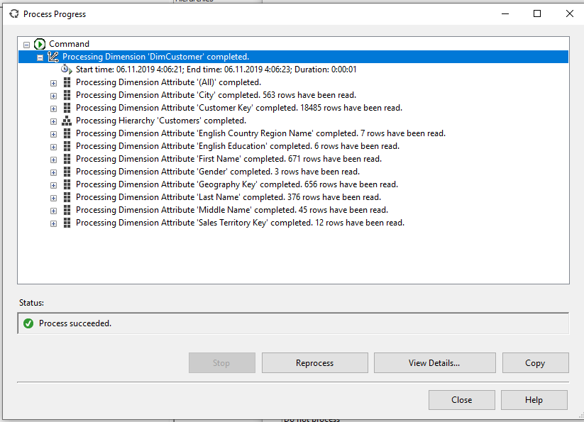
Развернуть размеры

Slide 13
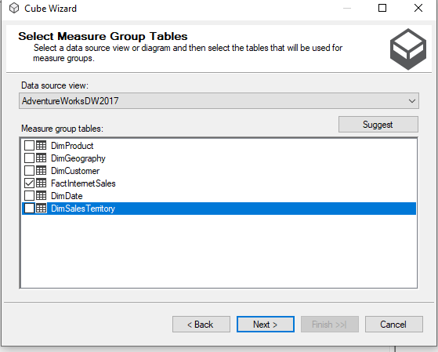
Создание куба
После развертывания измерений необходимо создать сам куб. Выбираем меры из одной таблицы

Slide 14
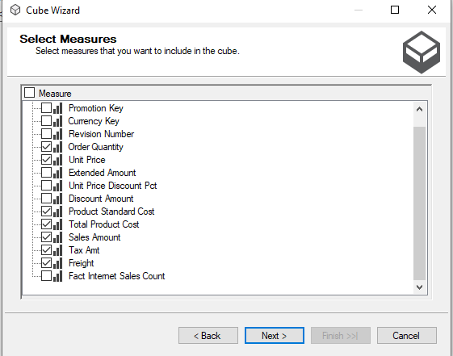
Создание куба

Slide 15
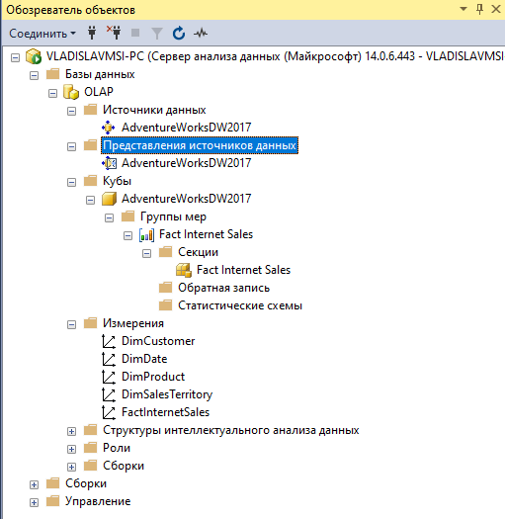
OLAP-КУБ
После развертывания куба подключитесь к службам Microsoft SQL Analysis Services.

Slide 17

MDX Dimensionality
MDX queries arrange Cube Dimensions on the Representation Dimensions ( hereafter referred as ‘Axis’ to avoid confusion )
e.g. retrieve Planned GSV measure for accounts E4098,E4398.
select
{
[Measures].[Planned GSV]
} on 0,
{
[Account].[Account Code].[E4098:47]
,[Account].[Account Code].[E4398:47]
} on 1
from [Cube REPORTING]

Slide 18
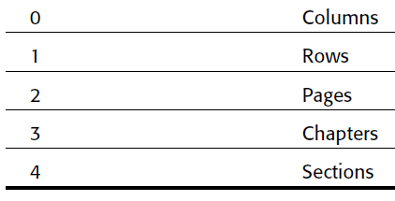
MDX Query – Axis Framework
MDX queries arrange Cube Dimensions on the Representation Dimensions ( hereafter referred as ‘Axis’ to avoid confusion )
e.g. retrieve Planned GSV measure for accounts E4098,E4398.
select
{
[Measures].[Planned GSV]
} on columns,
{
[Account].[Account Code].[E4098:47]
,[Account].[Account Code].[E4398:47]
} on rows
from [Cube REPORTING]
MDX provides names for each axis (till 4)

Slide 19

MDX query – Axis Framework
MDX queries primarily define Axis's
select
{
something
} on Axis(0),
{
Something else
} on Axis(1),
from [cube name]
select
{
[Account].[Account Code].[E4098:47]
,[Account].[Account Code].[E4398:47]
}
on Axis(0),
{
[Measures].[Planned GSV] } on Axis(1)
from [Cube REPORTING]

Slide 20
MDX query – Axis Framework
MDX queries primarily define Axis's
select
{
something
} on Axis(0),
{
Something else
} on Axis(1),
from [cube name]
Something ?
Something = set or tuple
Also note the structure of the basic MDX query

Slide 21
MDX query – tuple and SETS
Tuples
A tuple is a combination of members from one or more dimensions
-> not more than 1 member from a dimension ( same rule as co-ordinate geometry ) *
-> Many ways are there to specify a member.
( [Measures].[Planned GSV] ,[Time].[2010 HalfYear 1] )
( [Measures].[Planned GSV] ,[Time].&[64])
SETS
A Set is an ordered collection of Tuples.
select
{
[Account].[Account Code].[E4098:47]
,[Account].[Account Code].[E4398:47]
}
on Axis(0),
() – for tuples
{} – for sets
{
( [Measures].[Planned GSV] ,time.[2010 JAN])
,( [Measures].[Planned GSV] ,[Time].[2010 HalfYear 1] )
}
on Axis(0)

Slide 22
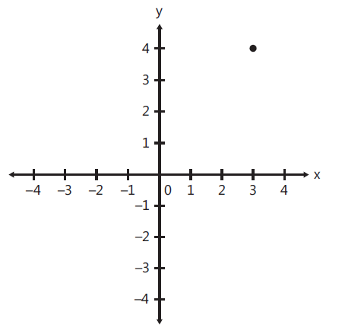
Understanding tuple
Best analogy - coordinate geometry *
2D –space
Tuple of the form (x₁,y₁ ) e.g. ( 3,4)
Tuple like (x₁,y₁ , y₂) or (x₁,x₂ , y₂) are invalid
Now apply same concept to n- dimensional cube
What are valid tuples ?
(time.year.[2011] , Product.brand.[B1])
(time.year.[2011] , Product.brand.[B1] , time.year.[2010])
(time.year.[2011] , Product.brand.[B1], Geo.[India])
(time.year.[2011] , Product.brand.[B1], Product.brand.[B2])
Understanding tuples are key to thinking in MDX .
We will stop here till all tuple related queries are clarified.
* This analogy holds good except for hierarchies. Hierarchies in cube space can be considered as dimensions in Co-ordinate geometry

Slide 23
MDX query – tuple and SETS
Something to remember
This is a set containing a single tuple
{
[Account].[Account Code].[E4098:47]
}
2. This is a single tuple
[Account].[Account Code].[E4098:47]
Both are Different things conceptually and programmatically (though SSAS overlooks it).

Slide 24
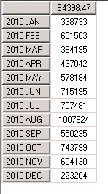
MDX query – tuple constructs
A closer look at tuple
elements separated by ‘ , ‘
Multi part identifier ‘ . ’
Can be of the form
Dimension.hierarchy.Level.member
[Time].[Time Hierarchy].[Month].&[421]
[Time].[Time Hierarchy].[Month].[2010 JAN]
Dimension.member
[Time].[2010 JAN]
Colon ‘ : ‘ used to represent a series of members
([Time].[2010 JAN]:[Time].[2010 DEC]) - all months from jan 2010 to dec 2010
select
{[Account].[E4398:47]}
on 0,
{([Time].[2010 JAN]:[Time].[2010 DEC]) }
on 1
from [Cube REPORTING]

Slide 25

MDX query – the children function
.Children
-- used to express the children of a member
e.g. as per Time hierarchy – month is the child of quarter
select { Time.[2010 Quarter 1].children }on 0,
{[Account].[E4398:47]} on 1
from [Cube REPORTING]

Slide 26
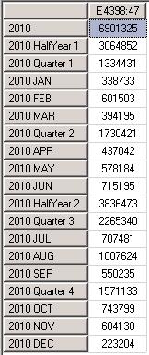
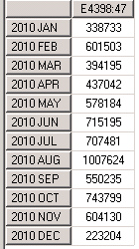
MDX query – the Descendatns function
Descendants (member [, [ level ] [, flag]] )
-- used to express the Descendant of a member at a level
Flag allows display
Select {[Account].[E4398:47]}
on 0,
{
descendants(Time.[2010],month,self)
} on 1
from [Cube REPORTING]
Select {[Account].[E4398:47]}
on 0,
{
descendants(Time.[2010],month,self_and_before)
} on 1
from [Cube REPORTING]

Slide 27
Assignment -1
Assume the following Dimensions :
Time : Year <- Quarter <- Month <- Day
Product : Dollar Sales, Unit Sales
Geo : country <- state <- city

Slide 28

Cross joins
Concept :
Two Sets - A ,B
A = {1,2,3} B = {x,y}
Cross join AxB
AxB = { (1,x), (2,x), (3,x), (1,y), (2,y), (3,y),}
Planned GSV for 2 accounts for 3 months --
select
{
(account.[Account Code].[E4098:47]),
(account.[Account Code].[E4400:47])
}
* -- cross join
{
time.[2010 JAN] : time.[2010 MAR]
}
on 0,
{
[Measures].[Planned GSV]
}on 1
from
[Cube REPORTING]

Slide 29
Filter
Concept :
Filter ( Set , Expression )
Accounts which have more than GSV
select
filter
(
(account.[Account Code].members),
[Measures].[Planned GSV] > 10000000
)
on 0,
{
[Measures].[Planned GSV]
}on 1
from
[Cube REPORTING]
.members gives all members of that level

Slide 30
Filter
What is the meaning of this ?
elect
filter
(
(account.[Account Code].members),
([Measures].[Planned GSV] ) > 10000000
)* -- cross join
{
time.[2010 JAN] : time.[2010 MAR]
}
on 0,
{
[Measures].[Planned GSV]
}on 1
from
[Cube REPORTING]

Slide 31

Filter
And this ?
select
filter
(
(account.[Account Code].members),
([Measures].[Planned GSV] ,time.[2010 JAN]) > 10000000
)* -- cross join
{
time.[2010 JAN] : time.[2010 MAR]
}
on 0,
{
[Measures].[Planned GSV]
}on 1
from
[Cube REPORTING]
Tuple reference is one of the powerful concepts in MDX

Slide 32
order
Concept :
Order (set1, expression [, ASC | DESC | BASC | BDESC])
Accounts ordered by GSV
select
non empty (
order
(
(account.[Account Code].members),
([Measures].[Planned GSV] )
)
)
on 0,
{
[Measures].[Planned GSV]
}on 1
from
[Cube REPORTING]

Slide 33
Accounts ordered by ???
select
non empty (
order
(
(account.[Account Code].members),
([Measures].[Planned GSV],time.[2011 JAN] )
)
)
on 0,
{
[Measures].[Planned GSV]
}on 1
from
[Cube REPORTING]

Slide 34



Tuple instead of expression used
The Where Clause
select
from
[Cube REPORTING]
where
([Measures].[Planned GSV] )
select
from
[Cube REPORTING]
where
([Measures].[Planned GSV],time.[2010 JAN] )
select
from
[Cube REPORTING]
where
([Measures].[Planned GSV],time.[2010 JAN] ,account.[Account Code].[E4400:47] )

Slide 35

Named Sets : Ease of reference
with set [great accounts] as
{
[Account].[Account Code].[E1373:47],
[Account].[Account Code].[E40301:47]
}
select
{
[Measures].[Planned GSV]
}
on 0,
non empty
{
[great accounts]
} on 1
from [Cube REPORTING]
Also possible to create persistent named Sets
create set [Cube REPORTING].[test accounts] as
{
[Account].[Account Code].[E1373:47],
[Account].[Account Code].[E40301:47]
}

Slide 36
Calculated members : the power of MDX !!!!
1. Simple Calculated members
Find the Average sales price ( i.e. Total Dollar sales / number of units sold ) for the quarters
2005 Q1 and Q2.
WITH
MEMBER [Measures].[Avg Sales Price] AS
[Measures].[Dollar Sales] / [Measures].[Unit Sales]
SELECT
{ [Measures].[Dollar Sales]
[Measures].[Unit Sales]
, [Measures].[Avg Sales Price] }
on columns,
{ [Time].[Q1, 2005]
, [Time].[Q2, 2005]
}
on rows
FROM Sales
Simple Division used to calculate a new measure
 | Dollar Sales | Unit Sales | Average Sales price
Q1, 2005 | 100 | 5 | 20
Q2, 2005 | 120 | 8 | 15

Slide 37
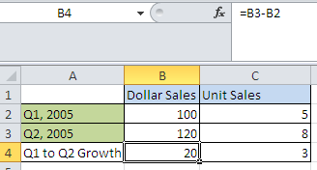
Calculated members : the power of MDX !!!!
2. Calculated members of medium complexity
Find the Quarter on quarter growth for Dollar sales and unit sales for the quarters
2005 Q2.
Growth in dollar sales = 2005 Q2 Dollar sales - 2005 Q1 Dollar sales
Growth in unit sales = 2005 Q2 unit sales - 2005 Q1 unit sales
WITH
MEMBER [Time].[Q1 to Q2 Growth] AS
[Time].[Q2, 2005] - [Time].[Q1, 2005]
SELECT
{ [Measures].[Dollar Sales]
, [Measures].[Unit Sales] }
on columns,
{ [Time].[Q1, 2005]
, [Time].[Q2, 2005]
, [Time].[Q1 to Q2 Growth] }
on rows
FROM Sales
WHERE ([Customer].[MA])
How does this take care of both subtractions ?

Slide 38
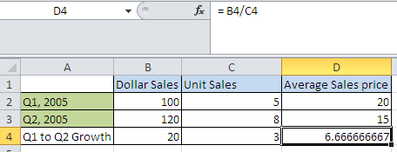
Calculated members : the power of MDX !!!!
Precedence resolutions
Combining previous two problems , write MDX to calculate Q1 to Q2 growth in average Sales prices
WITH
MEMBER [Measures].[Avg Sales Price] AS
[Measures].[Dollar Sales] / [Measures].[Unit Sales]
MEMBER [Time].[Q1 to Q2 Growth] AS
[Time].[Q2, 2005] - [Time].[Q1, 2005]
SELECT
{ [Measures].[Dollar Sales], [Measures].[Unit Sales],
[Measures].[Avg Sales Price]
}
on columns,
{ [Time].[Q1, 2005], [Time].[Q2, 2005], [Time].[Q1 to Q2 Growth] }
on rows
FROM [Sales]

Slide 39
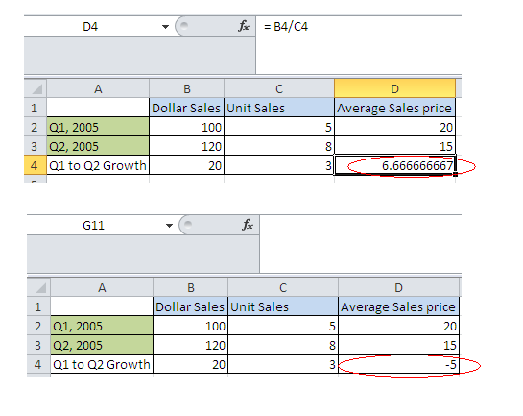
Calculated members : the power of MDX !!!!
Precedence resolutions
Combining previous two problems , write MDX to calculate Q1 to Q2 growth in average Sales prices
WITH
MEMBER [Measures].[Avg Sales Price] AS
[Measures].[Dollar Sales] / [Measures].[Unit Sales],
SOLVE_ORDER = 0
MEMBER [Time].[Q1 to Q2 Growth] AS
[Time].[Q2, 2005] - [Time].[Q1, 2005],
SOLVE_ORDER = 1
SELECT
{ [Measures].[Dollar Sales], [Measures].[Unit Sales],
[Measures].[Avg Sales Price]
}
on columns,
{ [Time].[Q1, 2005], [Time].[Q2, 2005], [Time].[Q1 to Q2 Growth] }
on rows
FROM [Sales]

Slide 40
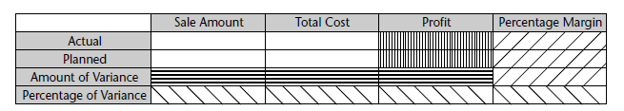
Calculated members : the power of MDX !!!!
Write an MDX to get the following result
Measures -> Measures.[Sales Amount], Measures.[Total Cost]
Dimensions -> Phase.Actual , Phase.Planned
Use normal formulas for profit , percentage margin , amount of variance, percentage of variance.

